Slide 1
Summer Work
2024-2025
Rising 2nd Grade
Name:______________________

Slide 2
Summer Work Information
Why do you have summer work?
Summer is a great time of the year! We all need time to rest and recharge, but we also need time to prepare for what is to come. To help you prepare for the next school year, we believe it is important to continue to problem-solve, think critically, respond creatively, and communicate appropriately. To accomplish these goals, we have an established summer routine that will consist of reading, writing, and math.
How do you turn in summer work?
A paper copy of your summer work is due to your homeroom teacher on the first day of school. Please do not email your summer work to your teacher over the summer. You may also choose to bring your work to Teacher Meet and Greet in July.
How will your summer work be graded?
You will receive a Math classwork grade and an ELA classwork grade for your summer work.
How do we communicate this summer?
We have emailed all parents a copy of the summer work packet, sent a copy home with you, and there will be an extra copy of the summer work packet on LOA’s website. We will check our email intermittently throughout the summer. If you should have any questions or should need to contact us, please email one of us at:
natasha.cannon@lakeoconeeacademy.org
heather.moon@lakeoconeeacademy.org
margaret.stanford@lakeoconeeacademy.org
lauren.taylor@lakeoconeeacademy.org

Slide 3
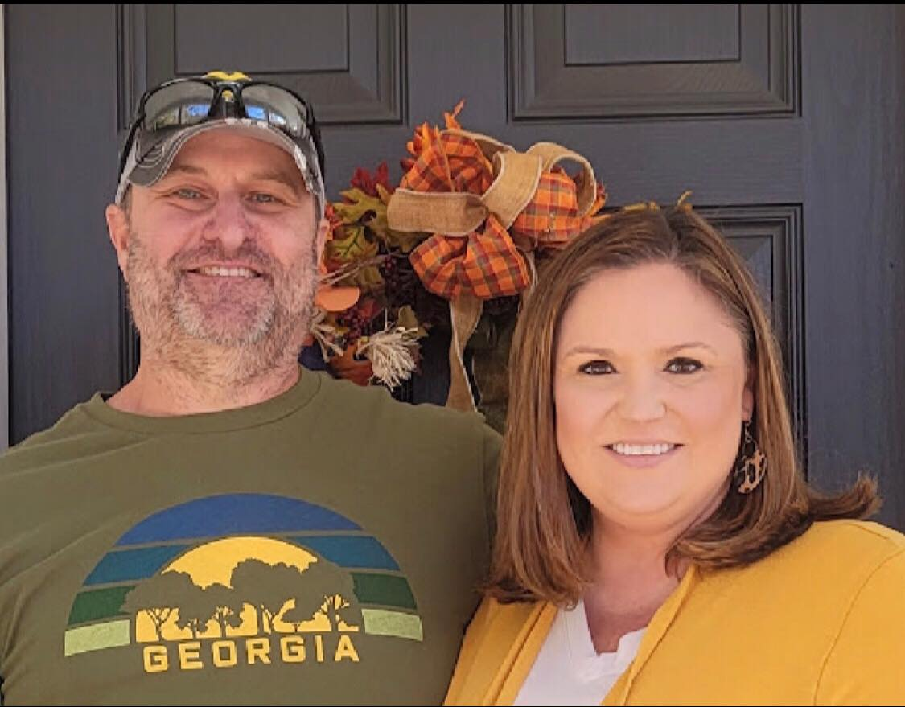
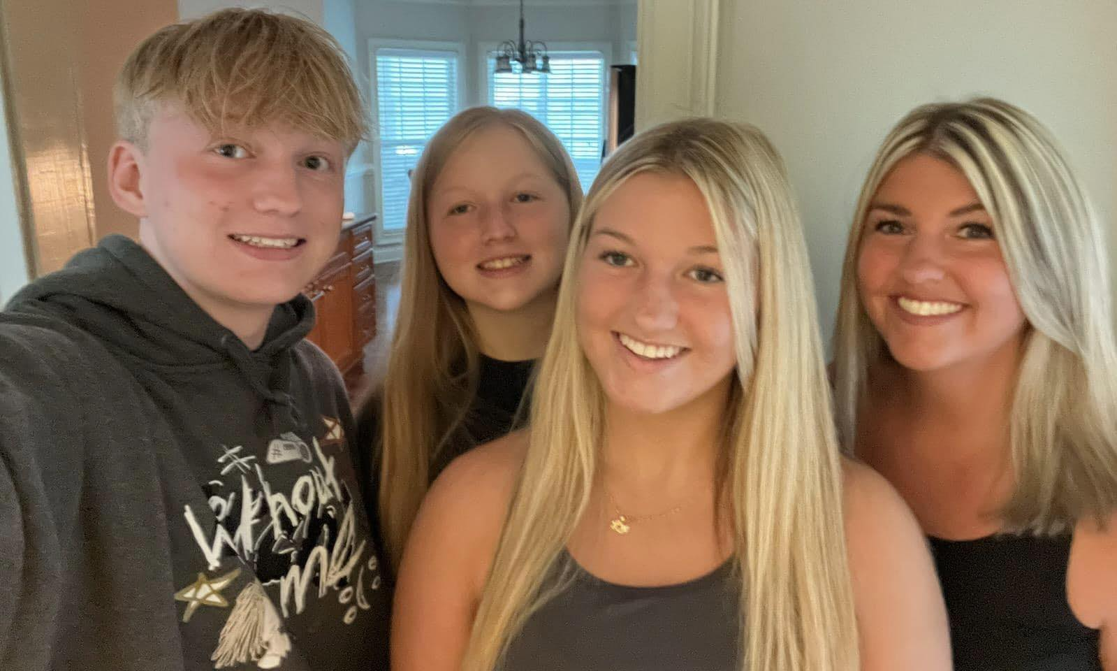
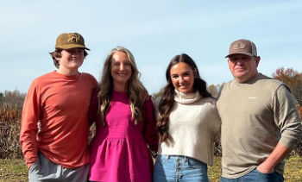
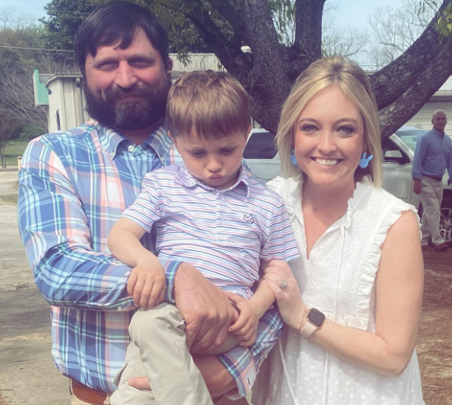
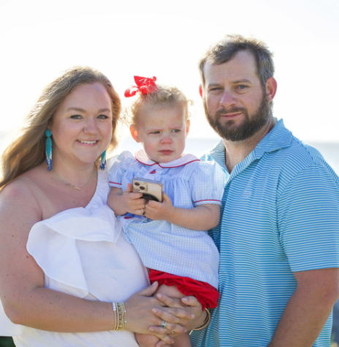
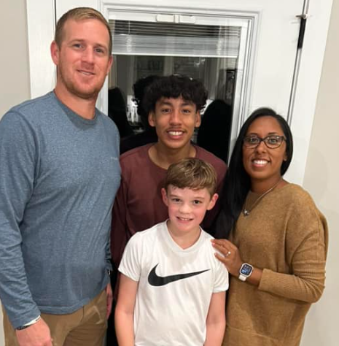
Ms. Cannon
2nd Grade
Mrs. Moon
2nd Grade
Mrs. Stanford
2nd Grade
Mrs. Taylor
2nd Grade
Mrs. Richards
Special Education
Ms. Jermaine
Assistant

Slide 4
Math Summer Work
Addition and Subtraction Math Facts, along with Story Problems, are important skills to maintain over the summer. Small daily practice (Monday-Friday) with each of these skills during the month of June is the expectation.
JUNE:
Each weekday in June, complete:
Math Facts Problem
Story Problem
Turn in your completed Summer Work on the due date!

Slide 5
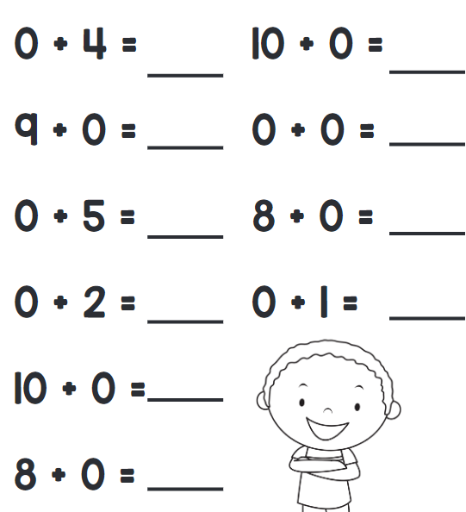
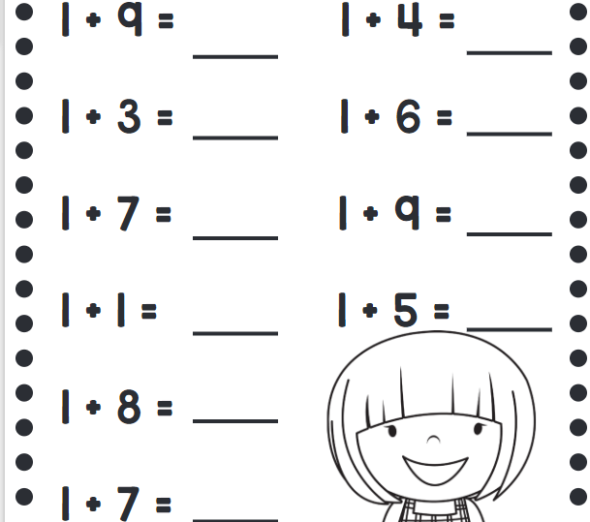
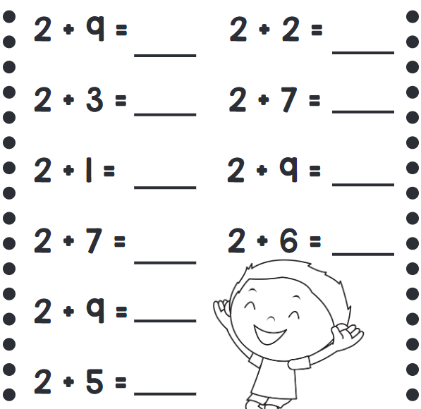
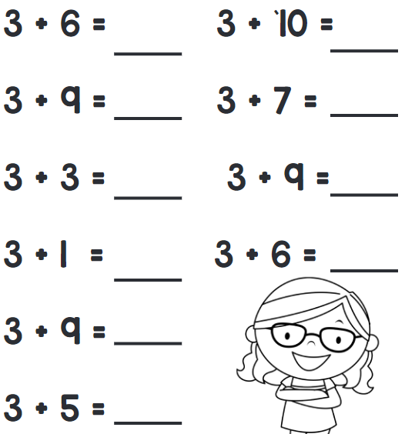
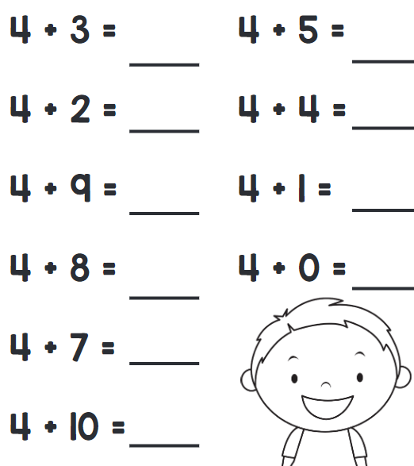
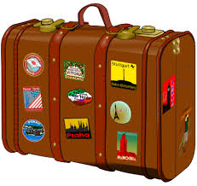
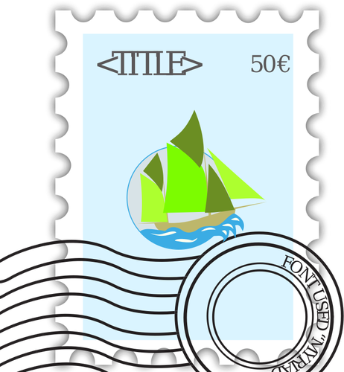
Week of June 3
Monday | Tuesday | Wednesday | Thursday | Friday
Mary has 14 stickers. She buys another 6 stickers. How many stickers does she have now? Mary has ________ stickers. | Mrs. Beck bought some apples. Her family ate 5 apples. She gave the remaining 4 apples to her friend. How many apples did she buy in the beginning? Mrs. Beck bought ____ apples. | Randy has 19 stamps. He gives 16 stamps to his brother. How many stamps does he have now? Randy has ________ stamps. | Josh has 8 cars. Rusty has 4 cars more than him. How many cars does Rusty have? Rusty has ____ cars. | James has 13 toy boats. Aaron has 6 toy boats. How many fewer toy boats does Aaron have than James? Aaron has ________ fewer boats.

Slide 6
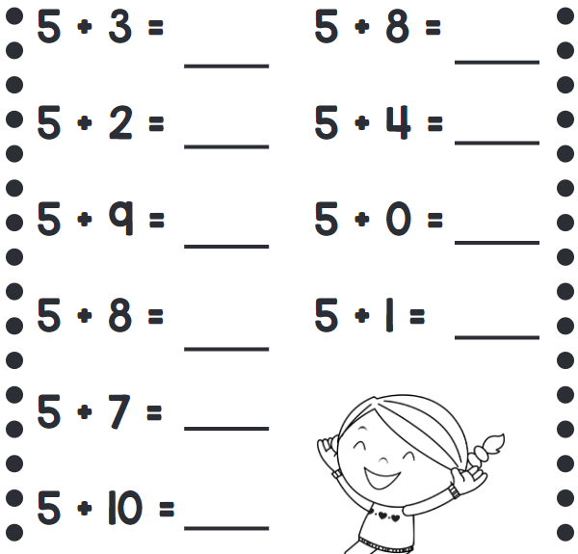
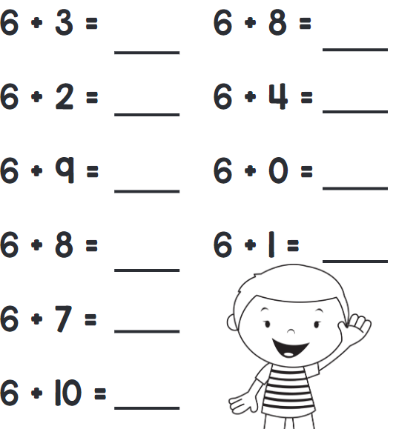
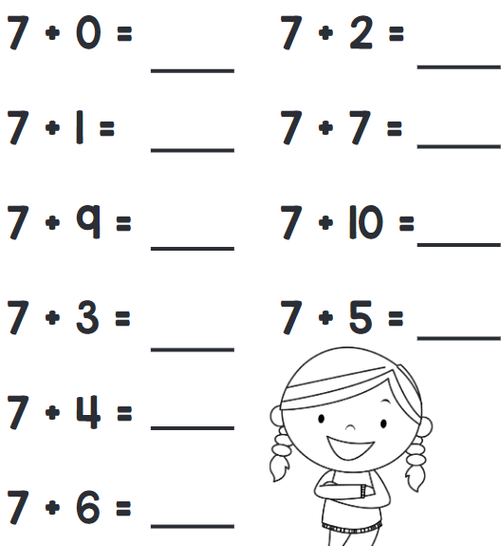
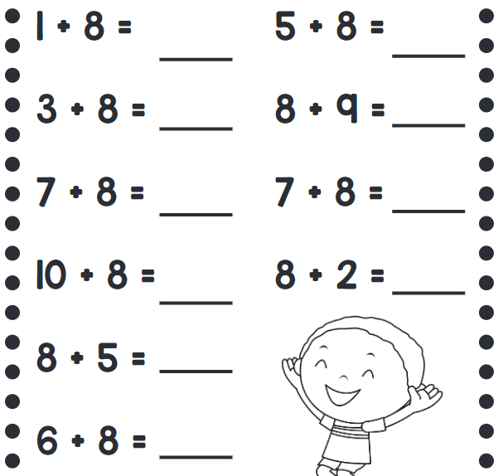
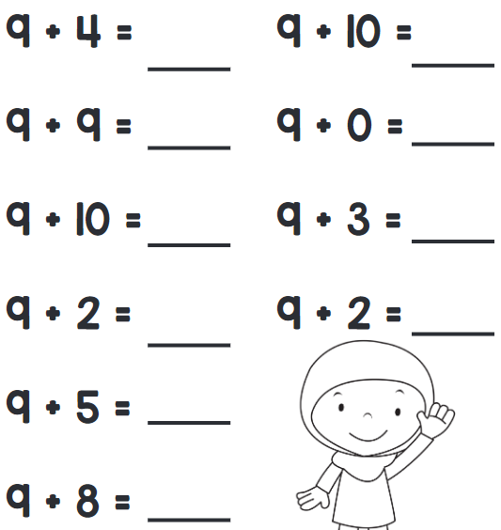
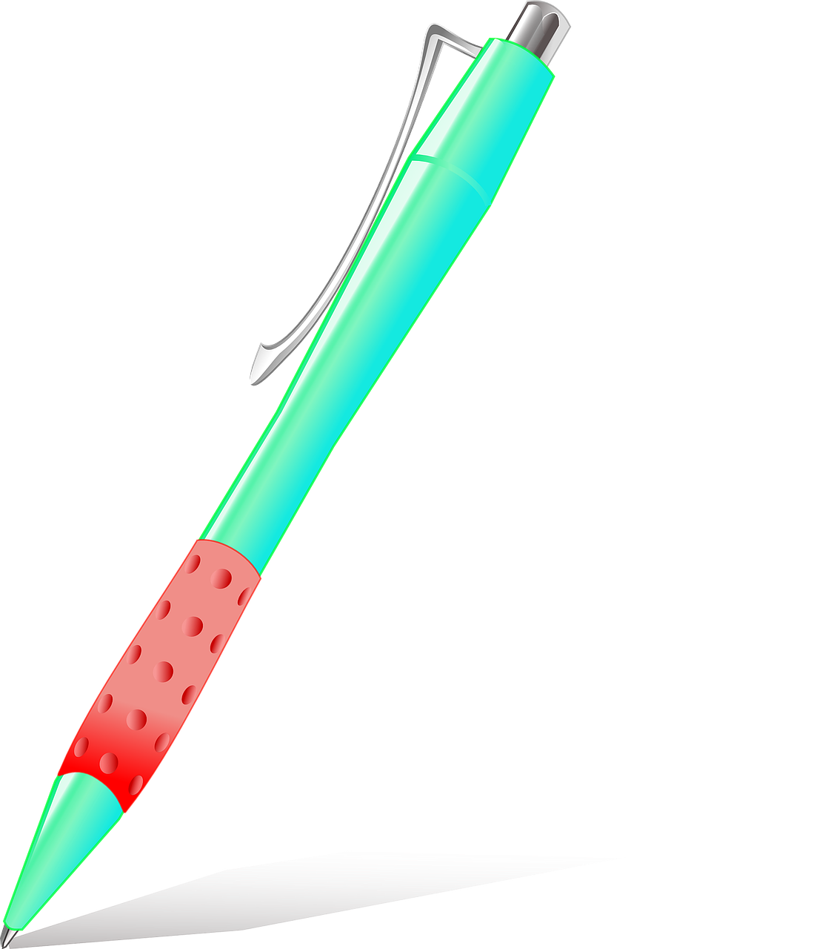
Week of June 10
Monday | Tuesday | Wednesday | Thursday | Friday
Eight ducks are swimming in a lake. Four more ducks join them. How many ducks are swimming in the lake now? There are ____ ducks swimming in the lake. | Michael had 14 pieces of cake. He ate 3 pieces of cake. How many pieces were left? Michael has _____ pieces of cake. | Penny had some pens. She kept 3 pens for herself and gave the remaining 8 pens to her friends. How many pens did she have in the beginning? Penny had ____ pens. | Mrs. Rojas needs 9 eggs to bake 6 cakes. She has only 4 eggs. How many more eggs does she need to bake the cakes? Mrs. Rojas needs _______ more eggs | Danny has 6 books. Drew has 3 books. How many books do they have altogether? They have ____ books.

Slide 7
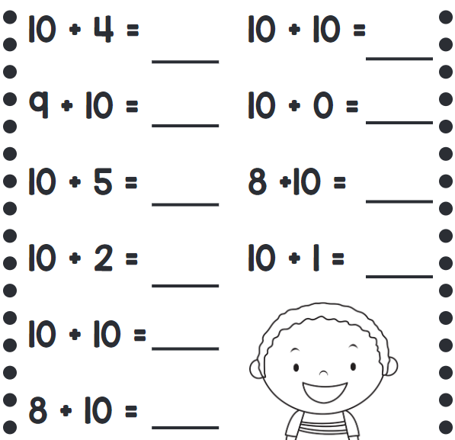
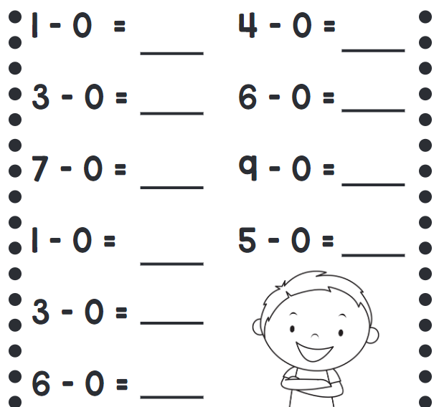
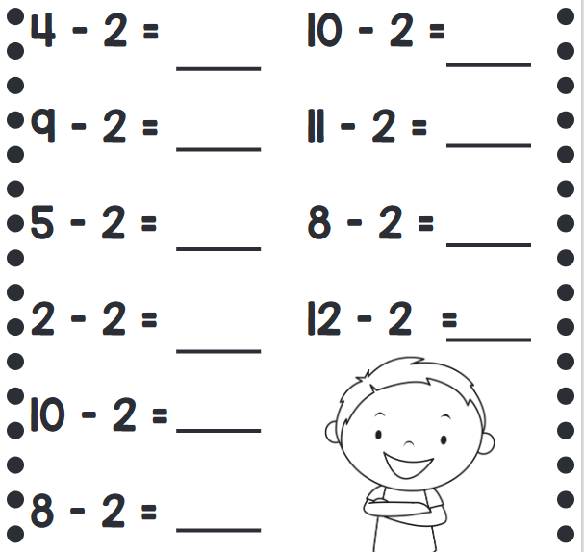
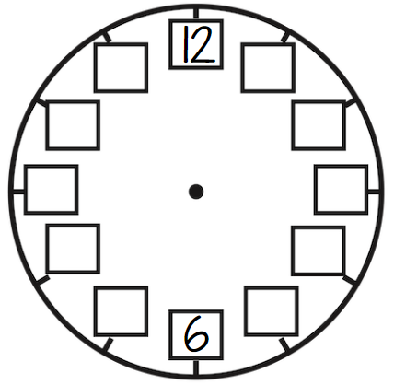
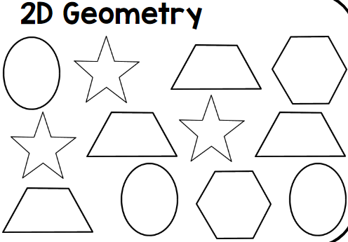
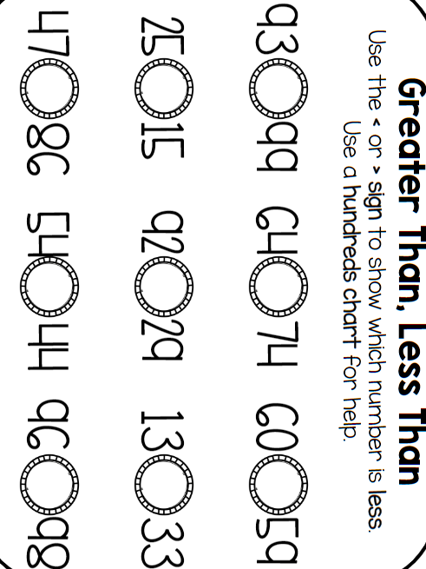
Week of June 17
Monday | Tuesday | Wednesday | Thursday | Friday
Dad gives Tommy 7 pens. Dad gives Dominic 4 pens. How many pens does Dad give to the two boys? How many more pens does Tommy have than Dominic? Dad gave the two boys ________ pens. Tommy has ________ more pens than Dominic. | Write the missing numbers on the clock. Jordan eats dinner at 7:00pm. Jordan goes to bed 2 hours after dinner. What time does Jordan go to bed? Draw hands on the clock to show what time Jordan goes to bed. | Draw an hour hand to show the time. Sarah eats lunch at 12:00. She has a snack 2 hours before she eats lunch. Draw a circle around the clock above that shows what time Sarah has a snack. | Color: 3 ovals, 1 hexagon, 2 trapezoids, 2 stars There are 3 ovals, 3 stars, 4 trapezoids, and 2 hexagons. Write a number sentence below to show how many shapes there are in all. ______ + ______ + ______ + ______ = ______

Slide 8
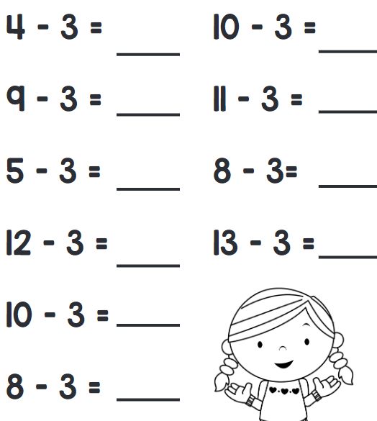
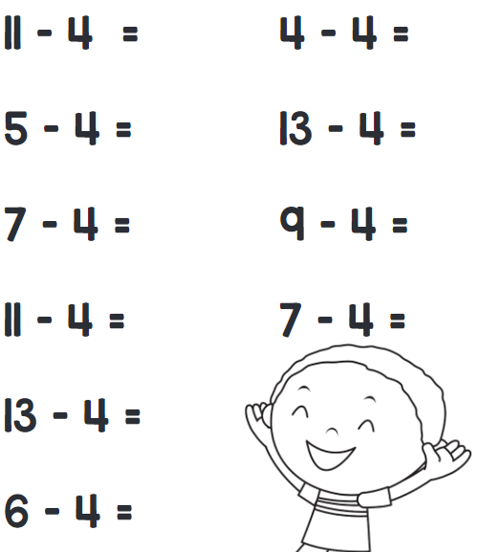
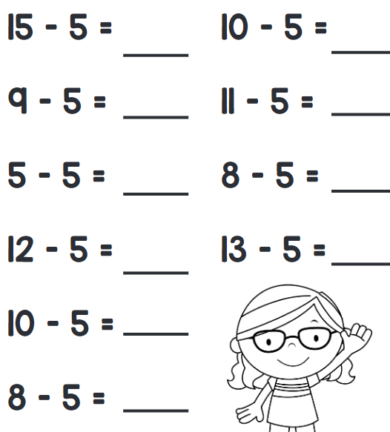
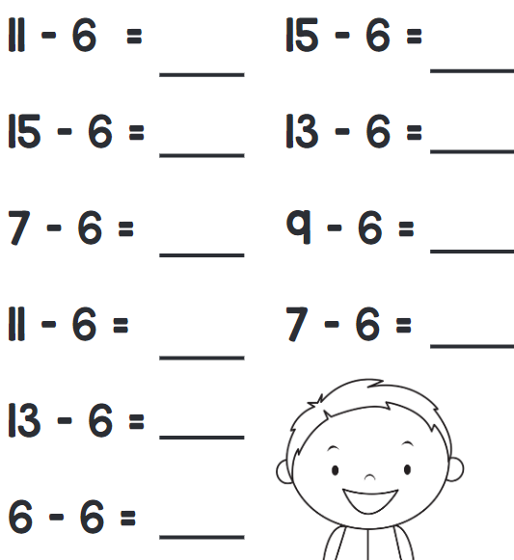
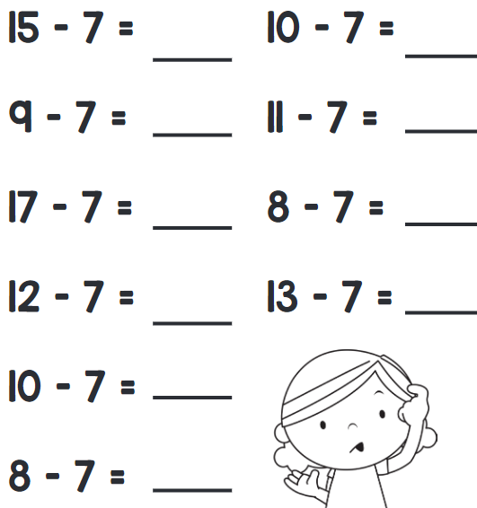
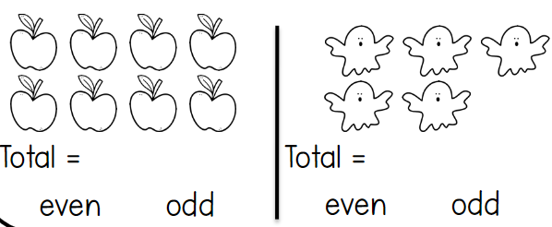
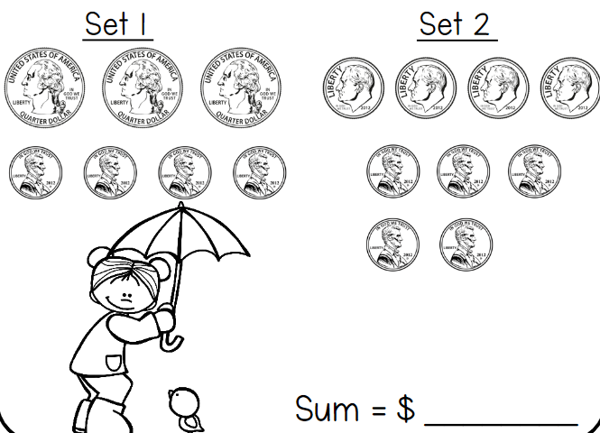
Week of June 24
Monday | Tuesday | Wednesday | Thursday | Friday
Circle the addition problem that matches the word problem: Shelly is counting insects in the yard. She counted three butterflies and six ladybugs. Later, Shelly counted two beetles. How many insects did Shelly count in all? | There are ____ more circles than triangles. | Read the time and draw the missing hand on the clock. Alec listens to music for 30 minutes before he goes to bed. Alec goes to bed at 9:00pm. Circle the clock that shows what time Alec starts listening to music. | Count the objects. Write the total and circle even or odd. Leelyn wants to fill out the table below by placing numbers in the correct category. Show her how you would fill in the table. 0 1 2 3 4 5 6 7 8 9 | Count each set of coins and add them together. Logan wants to purchase an umbrella for 60 cents. Which set of coins would give her enough money to purchase the umbrella? Set______.
Even | Odd

Slide 9
Reading Summer Work Directions
Reading Choice Board
Students will choose 1 book out of the options provided on the following page to read. This can be an independent or shared reading experience with someone else. On the next page, there are 4 book options that students can choose from along with the author’s name, a picture of the book cover, a summary of the book and online locations where the book can be purchased. Once students read the book, they will complete 1 assignment from the reading activity choice board below. Choose the reading response page that goes with the activity you choose from the choice board. Make sure to turn in your reading response page and ensure that your first and last name are clearly written on the page.
Illustrate Illustrate your favorite part of the book using as much detail as you can. Then, explain they this was your favorite part. | Story Summary Write what happened in the beginning, middle, and end of your story. Draw a detailed picture to go with each part. | Letter to the Author Write a letter to the author. Tell him or her what you liked or disliked about the book. Let them know what you thought of the characters and story.
New Title and Cover Brainstorm a new title for the book. Then, redesign the cover. After you've finished, write a paragraph explaining why you picked that title and cover design. | Compare and Contrast Choose a character from the book and yourself and illustrate them below. Compare and contrast yourself to the character. How are you similar? List ways you are similar in the middle. How are you different? List ways you are different on the sides. | Be the Teacher Create a 10 question quiz about the book you read. Include an answer key.

Slide 10
Reading Summer Work - Book Options
Book Title and Author | Book Cover | Summary | Purchase Online At…
Mercy Watson to the Rescue by Kate DiCamillo |  | To Mr. and Mrs. Watson, Mercy is not just a pig — she's a porcine wonder. And to the portly and good-natured Mercy, the Watsons are an excellent source of buttered toast, not to mention that buttery-toasty feeling she gets when she snuggles into bed with them. This is not, however, so good for the Watsons' bed. BOOM! CRACK! As the bed and its occupants slowly sink through the floor, Mercy escapes in a flash – "to alert the fire department," her owners assure themselves. But could Mercy possibly have another emergency in mind — like a sudden craving for their neighbors' sugar cookies? | Amazon Walmart Target Barnes & Noble
Harry by the Sea by Gene Zion |  | When Harry goes on a visit to the beach, he is mistaken for a sea creature when a big wave covers him with seaweed. Harry also has to hunt for his family beneath all the similar beach umbrellas. | Amazon Walmart Barnes & Noble
The Life of Ty: Non-random Acts of Kindness By Lauren Myracle |  | Ty Perry’s second-grade life is crazier than ever. He’s trying hard not to worry too much, but that’s not easy when his brain is filled with so many thoughts, like finally finding a pet for Baby Maggie, his sometimes-crazy classmates, and the dreaded neck-pinch-of-death. And then there’s his upcoming recitation about doing an act of kindness in front of the whole class! Ty remains his wacky, curious self in this bighearted second installment of the Life of Ty series. Practicing kindness, random or not, doesn’t take that much worrying after all. Being kind is part of being Ty. | Amazon Walmart Barnes & Noble
Henry and Mudge and the Forever Sea by Cynthia Rylant |  | One hot summer day, Henry, his father, and his 180-pound dog, Mudge, head for the beach. They enjoy awesome waves, hot dogs, cherry sno-cones, a rubber lobster, and side-stepping crabs. It seems their wonderful day could happily go on forever. | Amazon Walmart Target Barnes & Noble

Slide 11
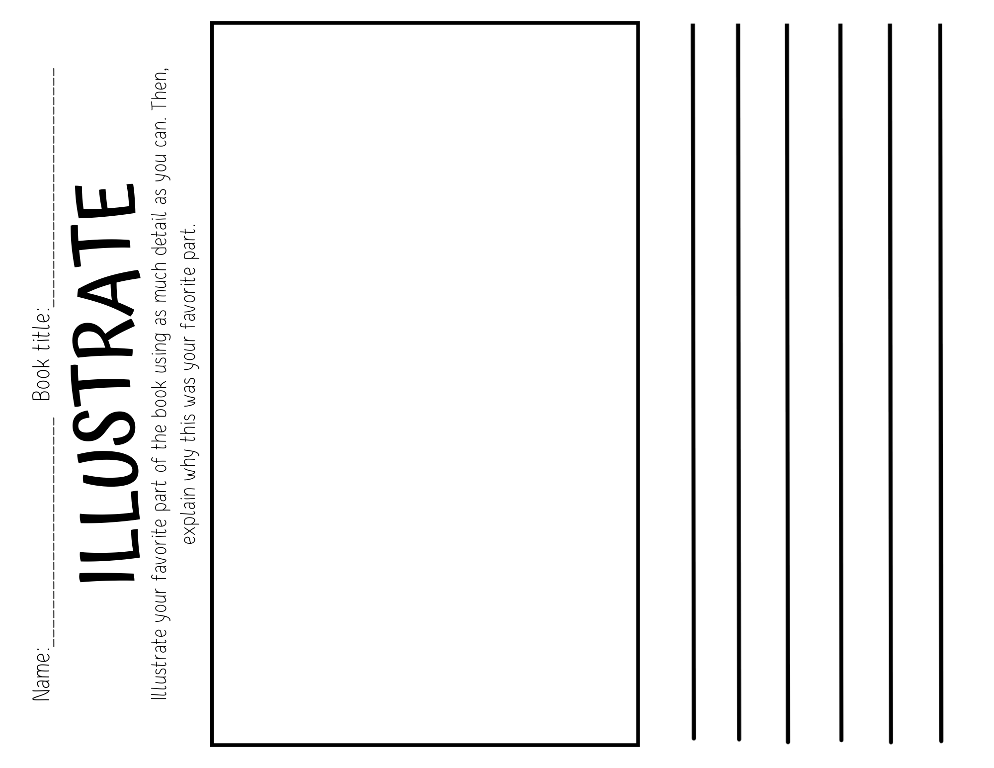

Slide 12
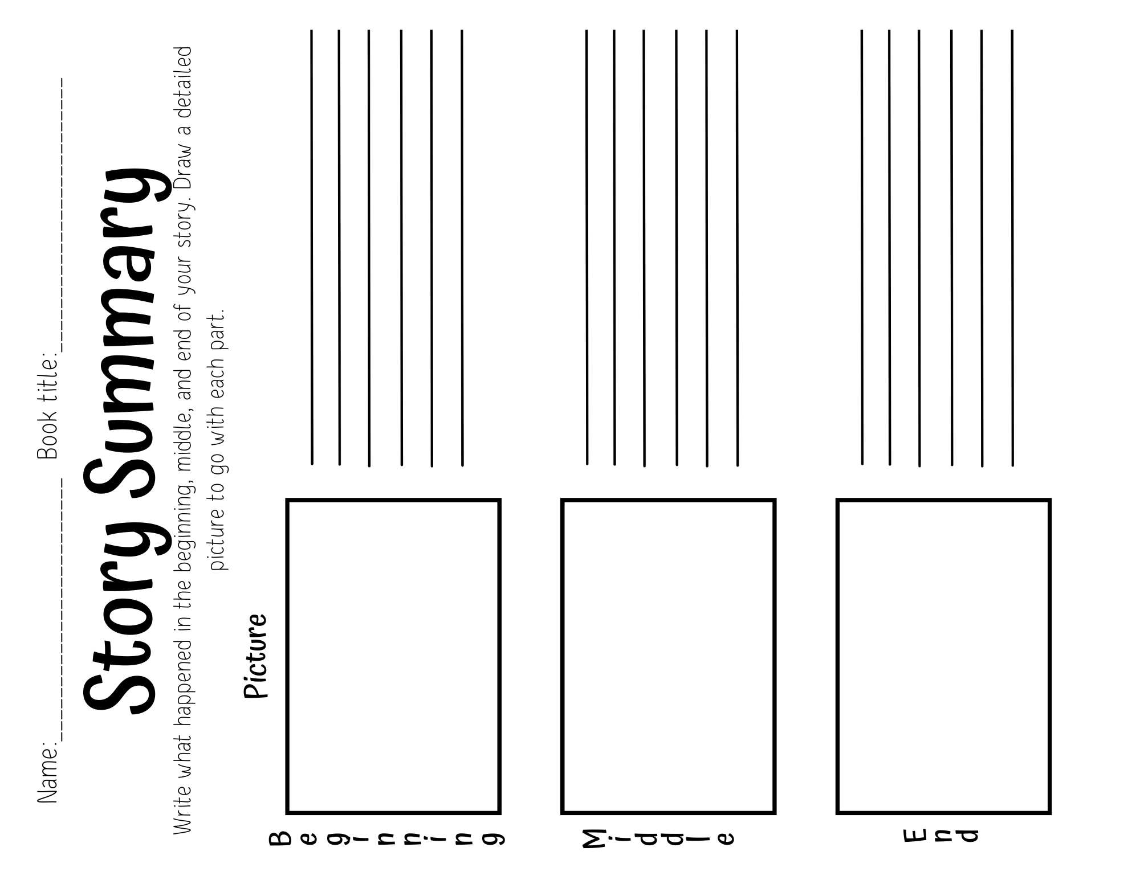

Slide 13
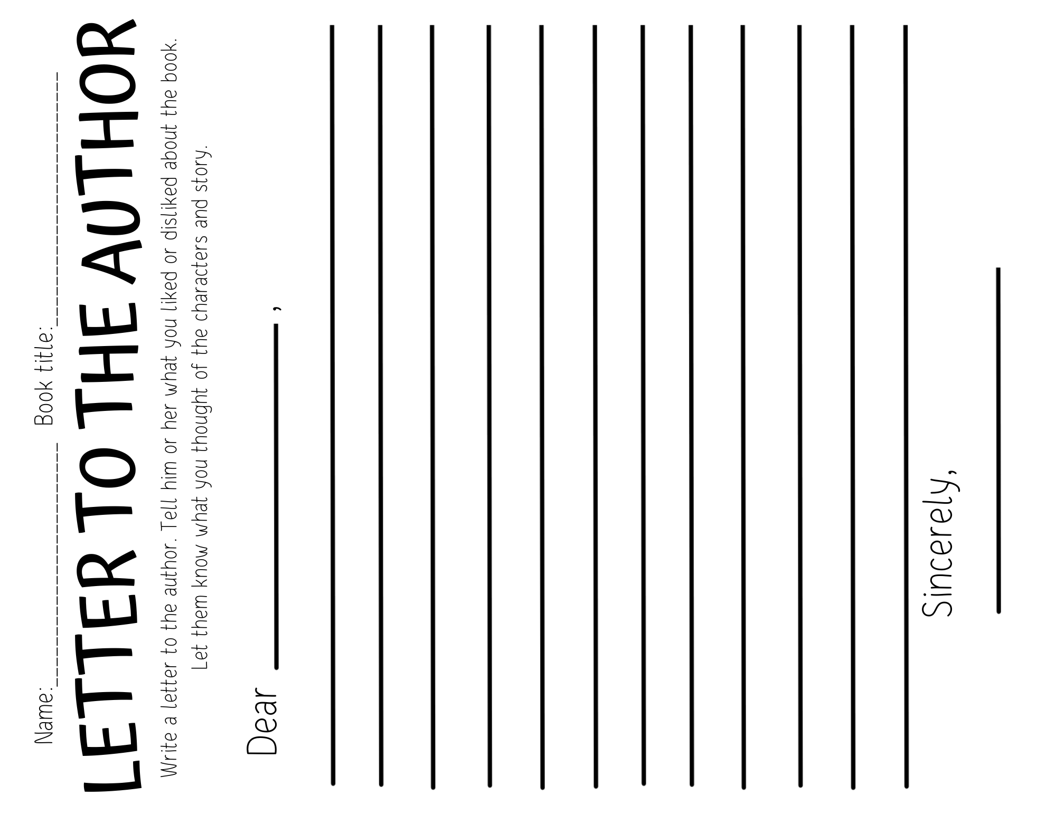

Slide 14
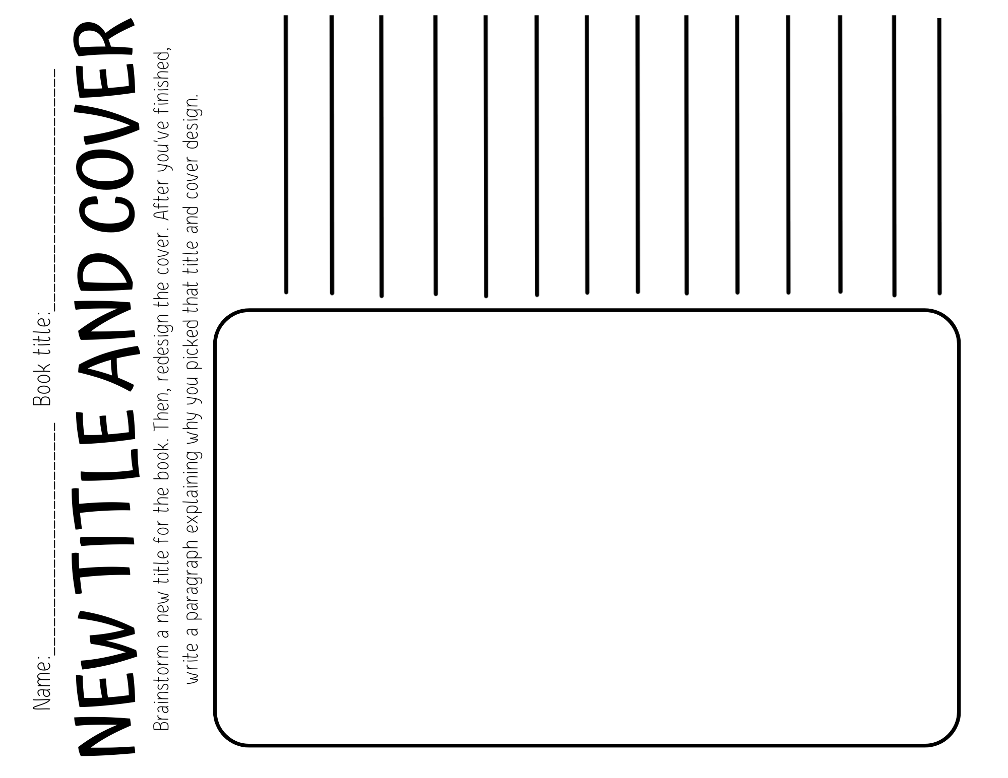

Slide 15
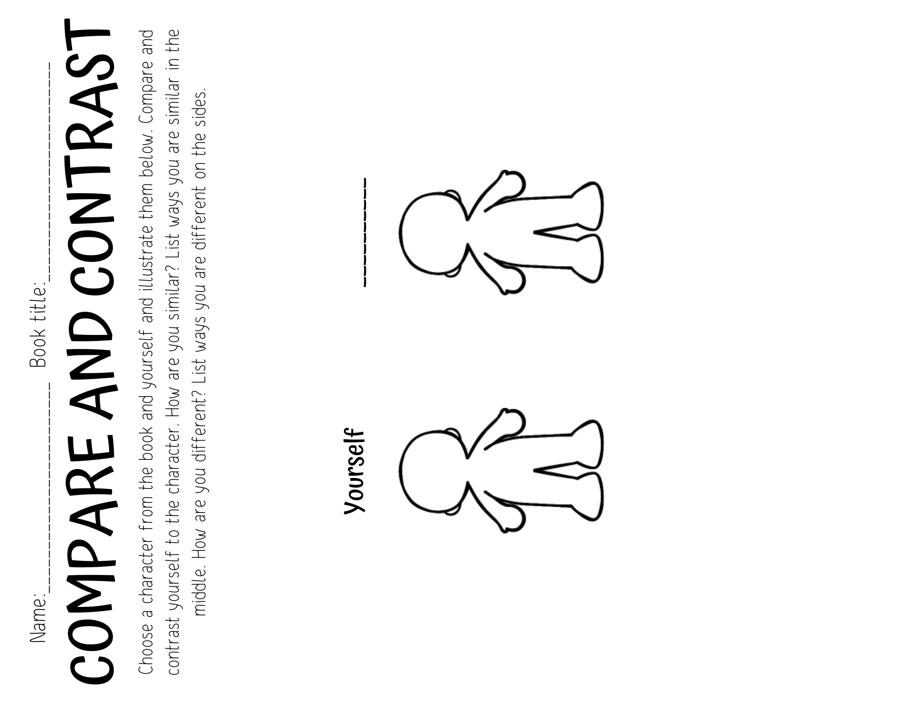

Slide 16
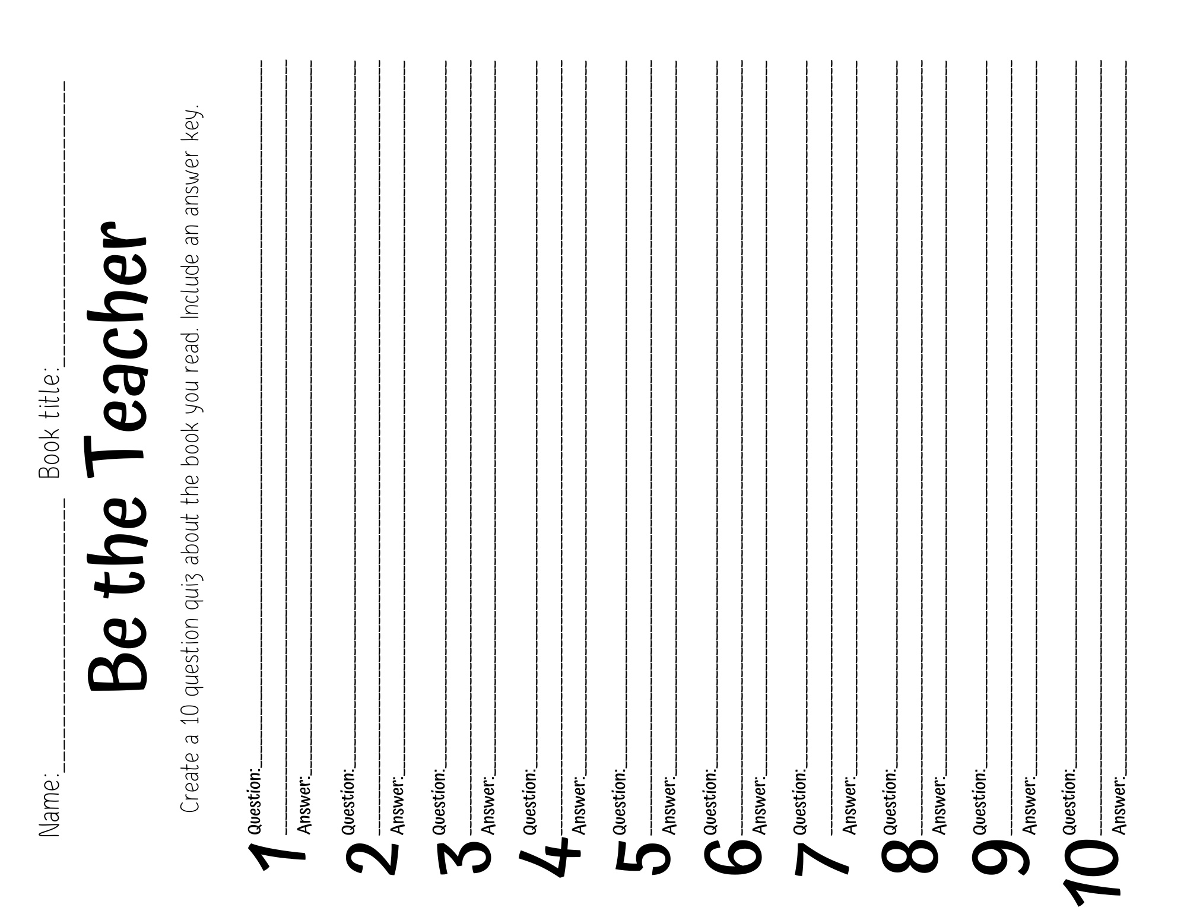

Slide 17
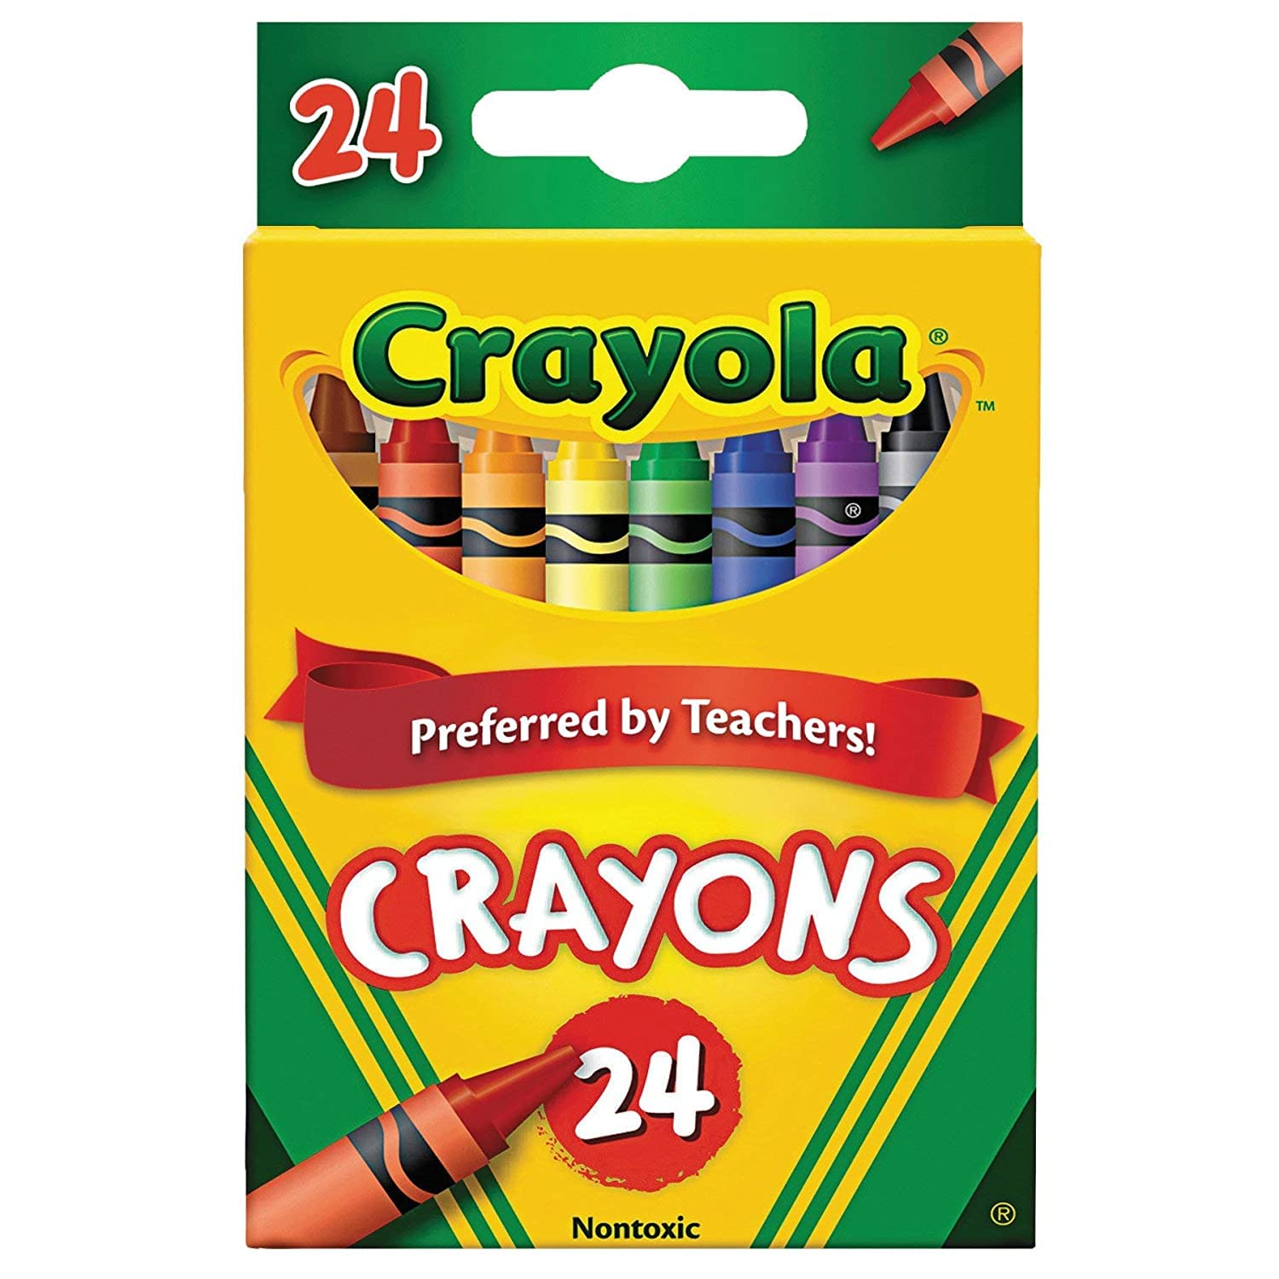
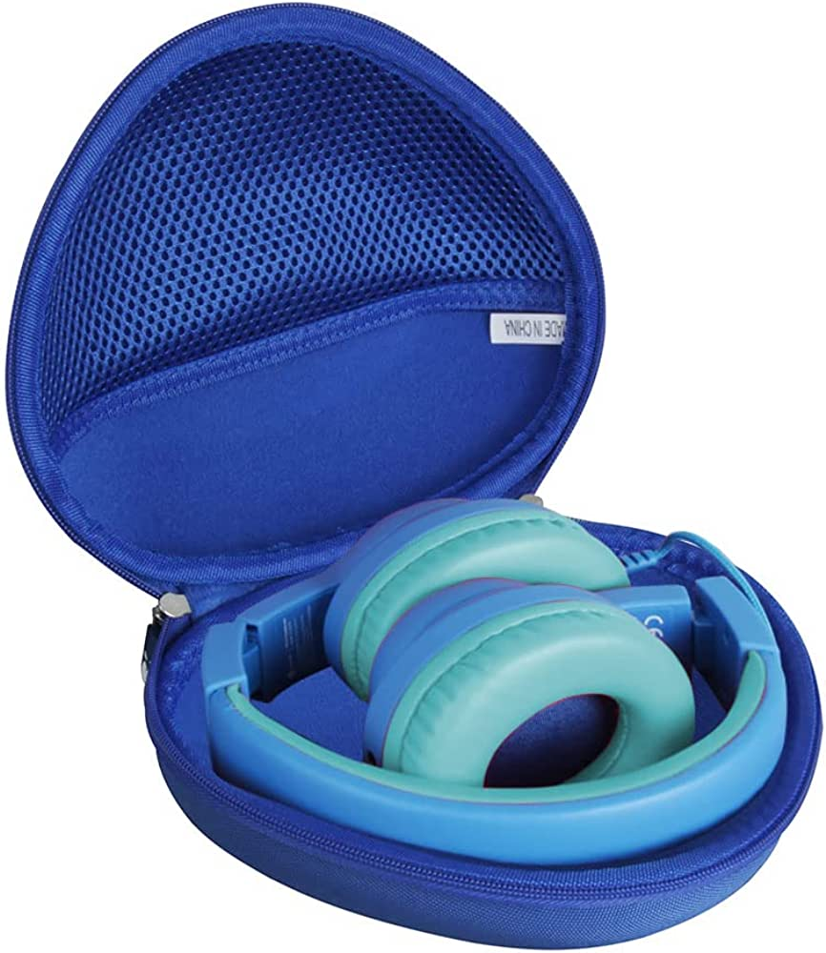
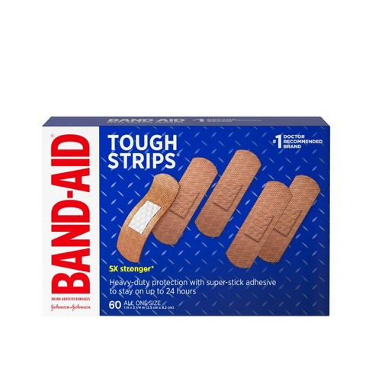
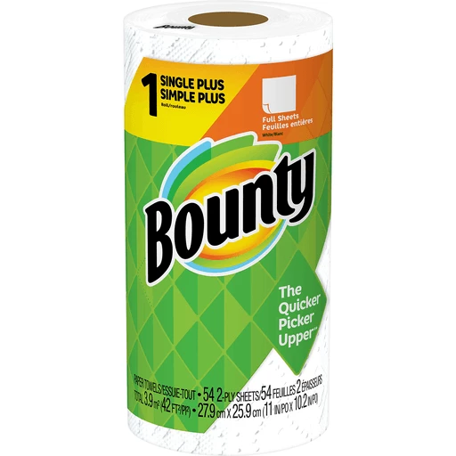
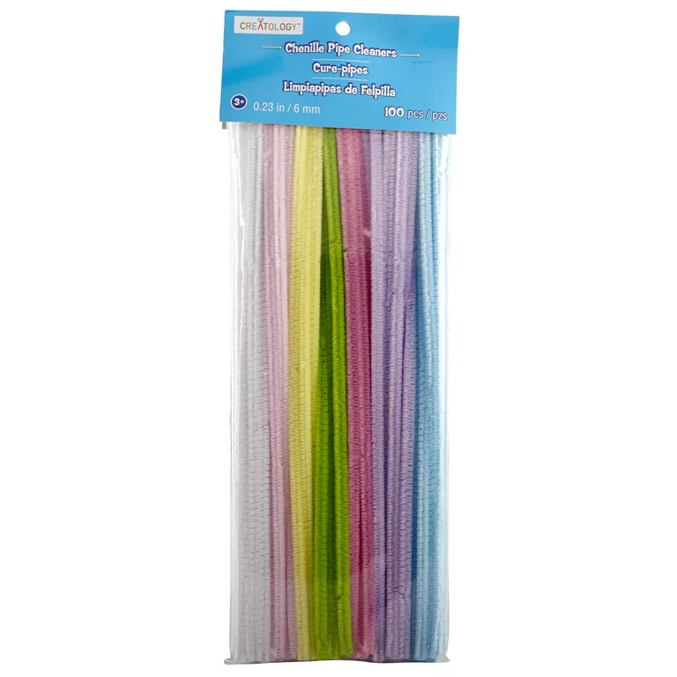
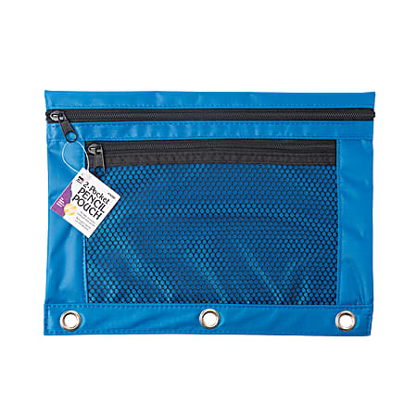
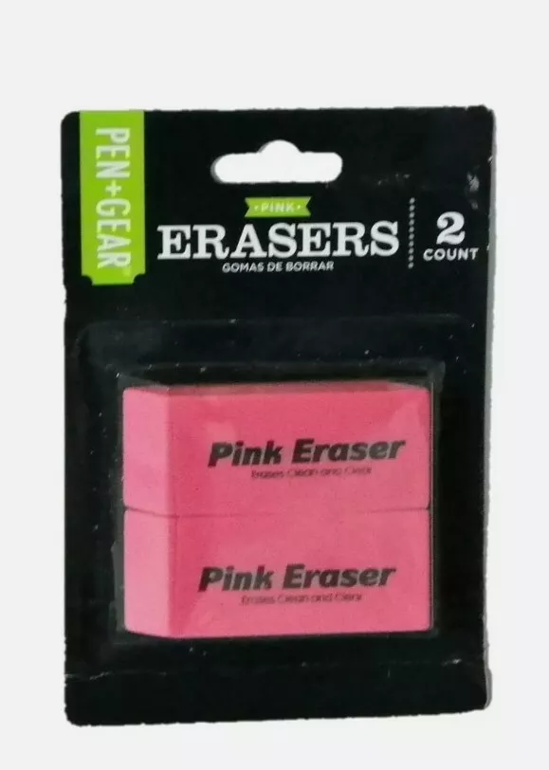
Rising 2nd Grade School Supply List
1 large pack of No. 2 Ticonderoga pencils (pre-sharpened)
2 boxes of Crayola Crayons-24 count
1 blue plastic folder with pockets
1 pack of 10 fine tip black Expo markers
1 pair of headphones
1 box of bandaids
1 roll of paper towels
1 pack of pipe cleaners
1 (3) ring binder pencil pouch
1 pack pink block eraser

