Slide 1
Student Name: ______________
Summer Work
2024
Rising 1st Grade

Slide 2
Summer Work Information
Why do you have summer work?
Summer is a great time of the year! We all need time to rest and recharge, but we also need time to prepare for what is to come. To help you prepare for the next school year, we believe it is important to continue to problem-solve, think critically, respond creatively, and communicate appropriately. To accomplish these goals, we have an established summer routine that will consist of reading, writing, and math.
How do you turn in summer work?
A paper copy of your summer work is due to your homeroom teacher on the first day of school. Please do not email your summer work to your teacher over the summer. You may also choose to bring your work to Teacher Meet and Greet in July.
How will your summer work be graded?
You will receive a Math classwork grade and an ELA classwork grade for your summer work.
How do we communicate this summer?
We have emailed all parents a copy of the summer work packet, sent a copy home with you, and there will be an extra copy of the summer work packet on LOA’s website. We will check our email intermittently throughout the summer. If you should have any questions or should need to contact us, please email one of us at:
katherine.bagley@lakeoconeeacademy.org
shay.craig@lakeoconeeacademy.org
leslie.whitton@lakeoconeeacademy.org
brittany.wisner@lakeoconeeacademy.org

Slide 3
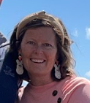
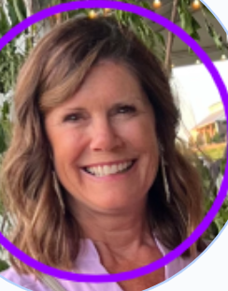
Welcome to First Grade! My name is Mrs. Craig and I can’t wait for our year together to start! I have lived in Greensboro my whole life! My husband, Mr. Craig, and I have been married for 12 years. We have
two sweet girls, Julia and Abby Lou. My husband and I both teach here, and both of our girls attend school here. This will be my 11th year teaching and my 6th year teaching First Grade. This year is going to rock!
Welcome to First Grade! My name is Mrs. Bagley, and I am thrilled to meet each and every one of you! My family moved to Greensboro from Gwinnett County in 2021 and we are loving life at the lake and LOA. My husband, Jeremy and I have been married for 18 years, and have three boys in 5th, 6th, and 9th grades. I have been teaching for 10 years, and First Grade is my very favorite! It’s going to be a great year!
Hello Firsties! My name is Mrs. Wisner. I live on a small family farm with my husband and our two kids, Maggie and Grady! I grew up in South Carolina and am a HUGE Gamecock fan! Our family loves to go to football games and be outdoors as much as possible! As the middle school cheerleading coach, I am full of LOA spirit! I am so EXCITED to get to know each of you!
Hi! My name is Mrs. Whitton and welcome to First Grade. This will be my 7th year teaching at LOA. I live on the lake in White Plains with my husband Rob and our dog Millie. We have been married for 33 years. We have three grown daughters and 1 grandson. I am so excited to get to know each of you this year!

Slide 4
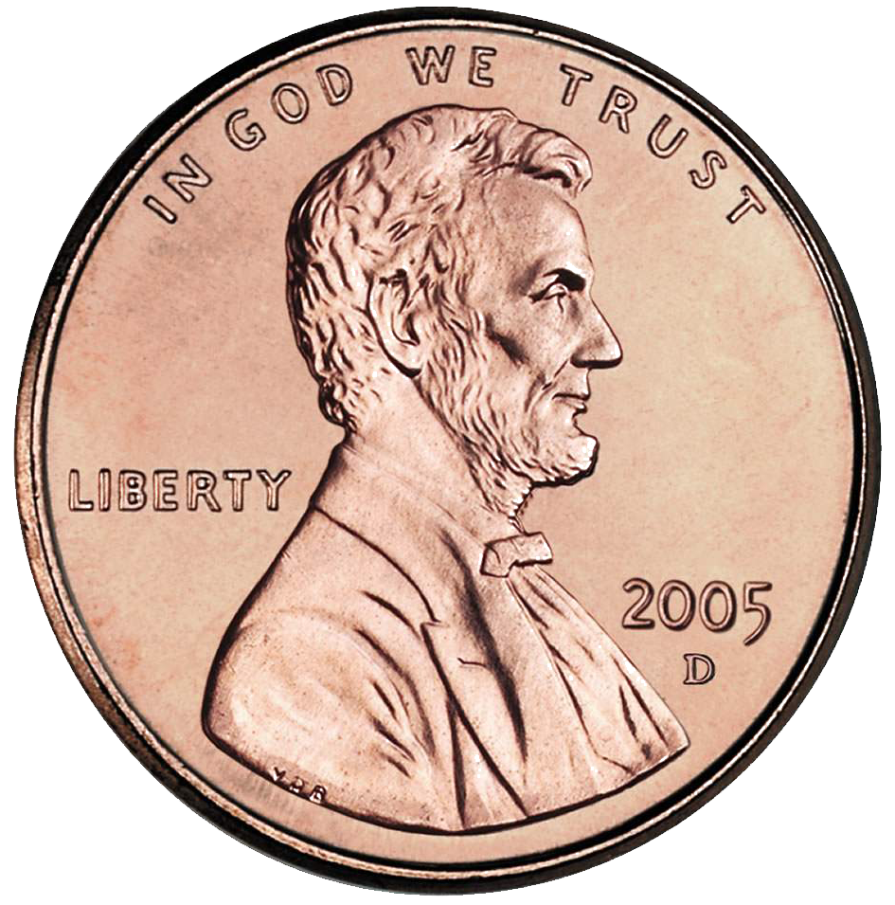
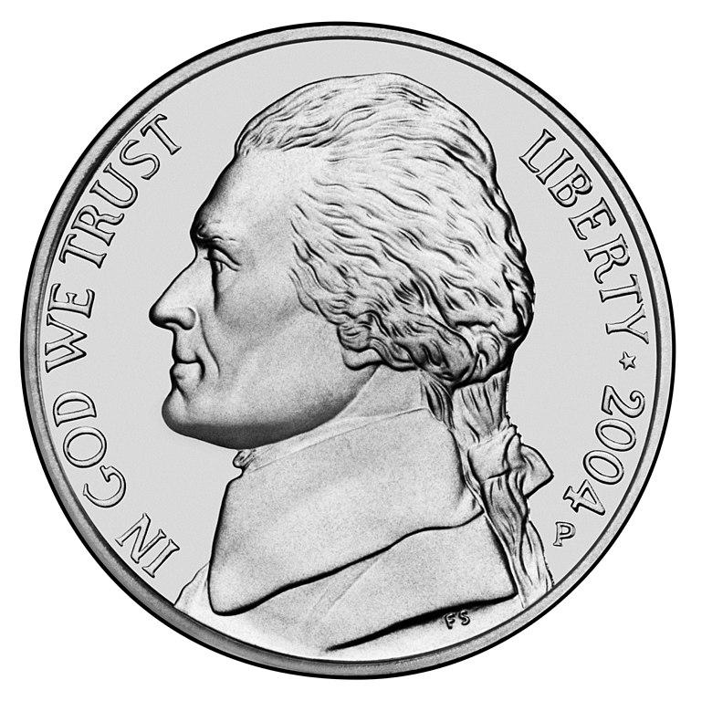
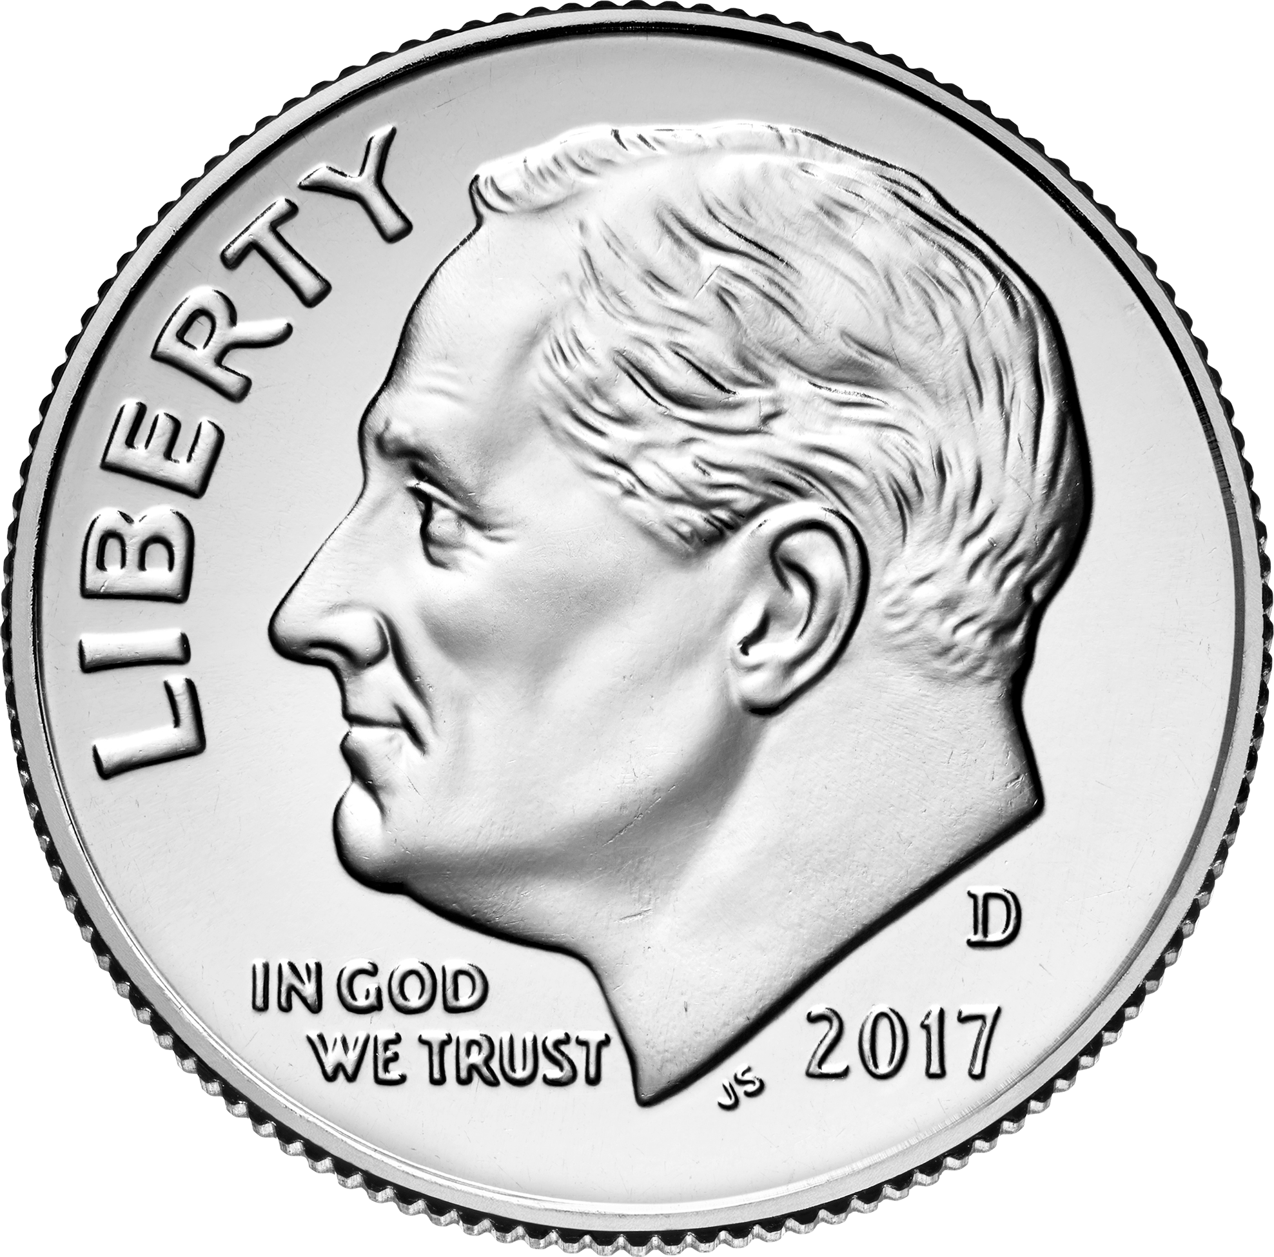
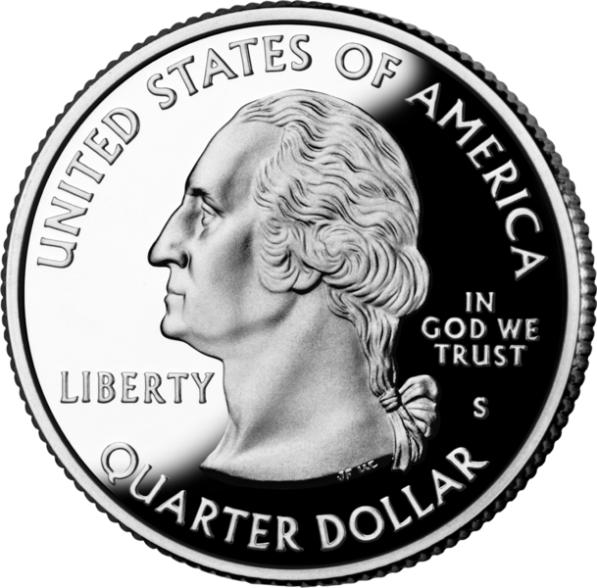
Math Summer Work
8 tiger sharks were swimming around together. 4 more tiger sharks joined them. How many tiger sharks were there altogether? | Ways to make 5. Write four different addition equations that equal 5. | What is the name and value of the coin? | Ways to make 6 Write four different addition equations that equal 6. | Draw a Triangle.
Draw 24 using tens and ones. | Ways to make 7 Write four different addition equations that equal 7. | There were 10 tropical fish swimming in a pool. 6 of them were angelfish. How many were not angelfish? | Ways to make 8 Write four different addition equations that equal 8. | Draw a trapezoid
Draw 49 using tens and ones. | 10 frisky dolphins were playing in the ocean. 8 went to find some food. How many dolphins were still playing? | What is the name and value of the coin? | Ways to make 10 Write four different addition equations that equal 10. | Draw a square.
What is the name and value of the coin? | True or False Explain your thinking 11+3=15 | A hungry shark ate 10 fish. How many more fish does he need to eat to have eaten 17 fish altogether? | What is the name and value of the coin? | Draw a rhombus.

Slide 5
ELA Summer Work
Count the number of syllables in… | Count the words in the sentence. | Do they rhyme? | Name 3 words that start with the same sound as fall. | Blend the sounds to read the words. m-a-n c-a-t r-i-b w-i-g
Count the number of syllables in… | Count the words in the sentence. | Do they rhyme? | Name 3 words that start with the same sound as cat. | Blend the sounds to read the words. t-o-p s-t-e-p r-u-b h-i-m
Count the number of syllables in… | Count the words in the sentence. | Do they rhyme? | Name 3 words that start with the same sound as man. | Tap the sounds in each word. set top man
Count the number of syllables in… | Count the words in the sentence. | Do they rhyme? | Name 3 words that start with the same sound as tack. | Tap the sounds in each word. bat dud lip

Slide 6
1st Grade Supply List
Primary Writing Journal with picture space (2)
Crayola Washable Markers 8 ct (2)
Black Expo Fine Tip Dry Erase Markers (8)
Blue Pencil Box (1)
3 Ring Fabric Pencil Pouch with clear front (1)
No2 Dixon Ticonderoga PreSharpened Pencils (24 pencils)
Crayola Crayons 24CT (4)
Elmer’s Small Purple Washable Glue Stick (24)
Sharpie Accent Highlighters 4CT (1)
Everyone for everybody Hand Soap (2)
Puffs Kleenex (2)
Unscented Baby Wipes (1)
Clorox Disinfecting Wipes (2)
Resealable Snack bags (1box)
Resealable Gallon Bags (1 box)
½” Avery White Durable View D-Ring Binder (1)
5 Star Blue Plastic Pocket Folder with prongs (1)
5 Star Yellow Plastic Pocket Folder with prongs (1)
Fiskars blunt tip scissors (1)
Paper Mate arrowhead PINK Pencil Top Erasers 6 pack (3)
Bounty select a size paper towels (4)
Astrobrights White Card Stock 8 ½ x 11 (1)
Astrobrights Happy Assortment Colored Card Stock 8 ½ x 11 (1)
Non- bluetooth Headphones (2)

